Slide 1












India Shines
Strong Roots

Slide 2



Unity Always
Shared Culture
Common Dreams Mutual Respect Collective Progress

Slide 3
Incredible
India blends ancient heritage and modern innovation, inspiring every generation
Our values and resilience shape the world with timeless wisdom and purpose

Slide 4
Diversity
Faiths
India embraces all beliefs, fostering unity through religious harmony Languages Each region speaks with cultural pride and grace

Slide 5
Values
Compassion, peace, and harmony guide Indian life always
Generations pass down truth, respect, and togetherness with care

Slide 6
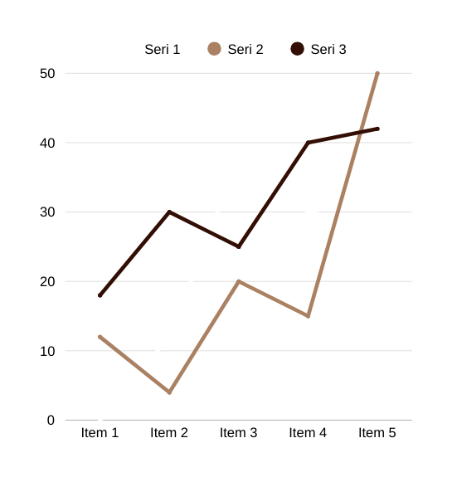
Progress
India thrives in space tech, digital growth, and youth-led innovation

Slide 7
Glory
Historic forts, spiritual centers, and art reflect India's rich past
Global Leaders Indians lead in science, tech, and governance worldwide

Slide 8



Strength

Slide 9
People
Every Indian contributes with strength, diversity, and spirit, lifting the nation with unity and global excellence

Slide 10
Vision
New India
Empowered youth build sustainable, inclusive dreams Future Path Growth guided by innovation and education Leading Ahead India shapes tomorrow with bold ambition

Slide 11
Jai Hind
Bharat First

